Slide 1
DISTRIBUTED MARKETPLACE WITH ESCROW
BERKE ATAC
OGUZ OZSAYGIN

Slide 2

INTRODUCTION
A marketplace is a platform where parties can sell and buy their products with respect to their interests.
Three main roles exists in marketplace trade transactions which are seller, buyer and shipping party.

Slide 3
INTRODUCTION
The seller post an item in the listing and any buyer can purchase it.
Once buyer purchase the item money is sent from its account to the system and locked in it.
A shipping company (a courier) may offer delivery services to ship the item to buyer in return of some fee (in percentage).
If buyer gets the product, it verifies the transaction and money unlocked is sent to seller and shipping company.
Moreover, shipping company increase their reputation for each successful delivery.
Otherwise, buyers cancel the transaction and money unlocked returns to buyer again.

Slide 4

MOTIVATION
All money is held on the website's bank account. This causes a security flow in operations because all money transfer operations may fail with a single point failure.
The owner of the website may deceive parties and go missing with the money on the hold.

Slide 5
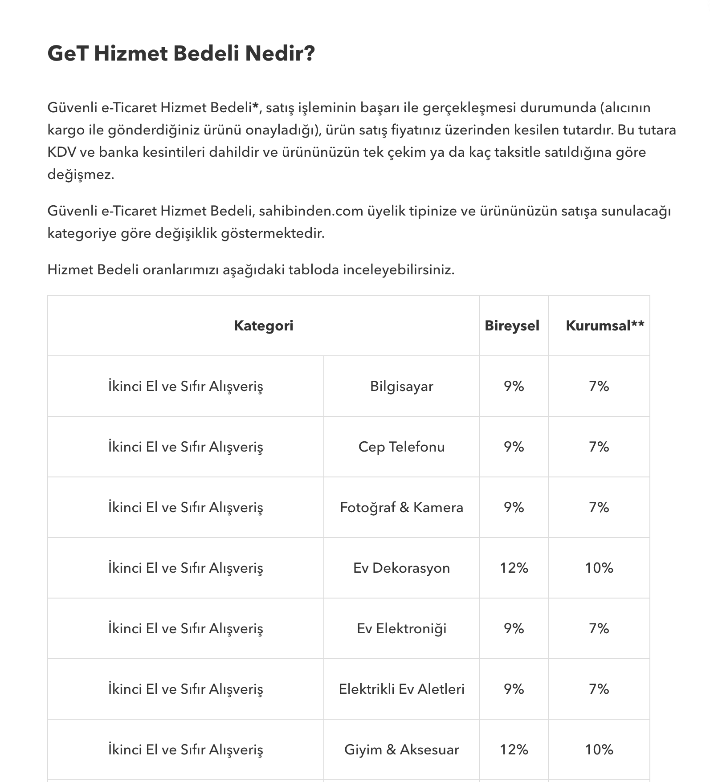
MOTIVATION
Parties taking place in trades do not trust each other and need a trusted third party to securely perform the money transfer operation.
Websites get overcharged commissions in each purchase operation.
We believe that the cost of money storing operations can be more much less than current commission rates offered by e-commerce companies.

Slide 6
IMPLEMENTATION
Build with Web3JS, TruffleJS, ReactJS
Items are stored in blockchain for immutability of data.
No extra database used
Smart contract provides an API for marketplace functionality (create, purchase, verify methods)
Tested in Ropsten testnet

Slide 7
FORMAL SECURITY ANALYSIS

